Slide 1
Policy impact on mobility
A Team Has No Name: Jenny Zhen, Li Cao, Yuyang Zhang

Slide 2



OUR TEAM
YUYANG yang
Jenny zhen
Li cao

Slide 3
Problem statement
How past policies affect mobility across six categories
Retail and recreation
Grocery and pharmacy
Parks
Transit stations
Workplaces
Residential
2. Help communities with future policy makings

Slide 4
Project purpose
01. Quantify policy effects
02. Predict mobilities
Calculate effects of different policies on mobilities changes in respect of baseline percentage.
Predict future 7 days mobilities with respect of confirm cases and active policies.
03. Pipeline for future use
Significance
Prepare a deliverable pipeline for communities to mimic possible effects on mobilities caused by new policies.
1. Investigate how policies affect mobility can help better understand the COVID-19 spreading;
2. Insights on how to smoothly transit to next phase for recovery.

Slide 5
Datasets
State-wide, 2020/2/15-2020/6/7 (114 days)
Unit of analyses: Days
Policies implementation date: https://github.com/KristenNocka/COVID-19-US-State-Policy-Database
Mobilities change compared to baseline days: https://www.google.com/covid19/mobility/
COVID-19 confirmed cases: https://console.cloud.google.com/marketplace/details/usafacts-public-data/covid19-us-cases?filter=category%3Acovid19&id=3eaff9c5-fbaf-47bb-a441-89db1e1395ab
Notes:
The baseline day is the median value from the 5‑week period Jan 3 – Feb 6, 2020.

Slide 6
Feature Engineering
01
02
Select 18 policies by domain knowledge and personal experience
Policies dummy encoded with effective dates and weekend encoded for bayesian model
03
04
Log transform for confirmed cases to alleviate sparse problem
Impute parks mobility missing values by using na.kalman

Slide 7
01.
Quantify policy effects
State clustering & Policy clustering; Retail and recreation mobility

Slide 8
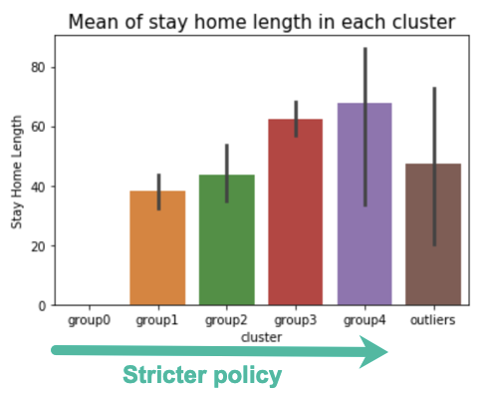
State clustering - based on All policies implementation
STATE Clusters (T-SNE, DBSCAN)
0: WY, IA, OK, TX, ND, UT, AR, KY | 1: TN, OH, WV, NV, MT, WI, MS, MN, LA, AL, AK, AZ, ID, GA, KS
2: IN, VT, CO, SC, RI, MO, FL, IL | 3: DC, NJ, ME, WA, VA, MD, MA, MI, PA
4: CA, HI, OR, CT, NY | Outliers: DE, NE, NC, NM, SD, NH
Notes:
NY, CA, NJ, PA, MI are in cluster 3 or 4, stricter policies.
WY, ND (North Dakota), OK (Oklahoma) are in cluster 1, loosen policies.

Slide 9
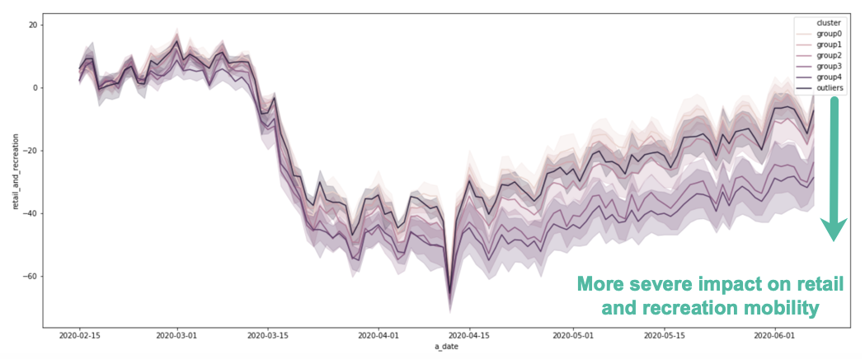
Retail and recreation mOBILITY TREND of State clusterS
Notes:
Mobility increase or lower mobility in general

Slide 10
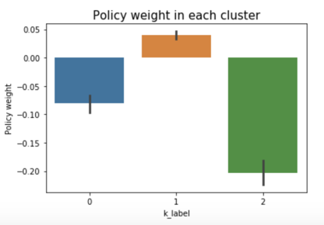
Policy clustering - based on mobility change around policy date
POLICY Clusters (T-SNE, K-means)
0: slightly decreased mobility | Stay at home in place, close non-essential business...
1: moderately increased mobility | Reopen businesses, restaurants, movie theaters, gyms
2: significantly decreased mobility | Close restaurants, schools, movie theaters, gyms
Notes:
5 days before & after….
STEMERG: State of emergency
CLDAYCR: Closed day cares
STAYHOME: Stay at home/ shelter in place
CLBSNS: Closed non-essential businesses
EVICENF: Stop enforcement of evictions
EVICINTN: Stop Initiation of Evictions
CLNURSHM: Date banned visitors to nursing homes
ENDREST: Reopen restaurants
END_BSNS: Began to reopen businesses
END_STHM: End/relax stay at home/shelter in place
END_MOV: Reopened movie theaters
ENDGYM: Reopened gyms
FM_EMP: Mandate face mask use by employees in public-facing businesses
FM_ALL: Mandate face mask use by all individuals in public spaces
CLREST: Closed restaurants except take out
CLSCHOOL: Date closed K-12 schools
CLMOVIE: Closed movie theaters
CLGYM: Closed gyms

Slide 11
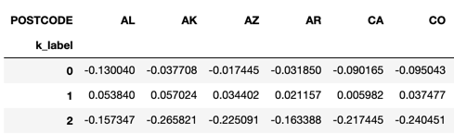
CALCULATE pOLICY SCORE
Calculate policies weights for each cluster and each state
Policy Scores = dot product of policies weights and policies dummy tables for 51 states and 3 clusters
Policy Scores will be used as input for our predictive models on mobility

Slide 12
02.
Predict mobilities
Use Arimax to predict mobilities values in respect of confirm cases and policies
Apply Bayesian framework on linear regression with ensemble method

Slide 13
ARIMAX
Why arimax
pARAMETERS
Mobility train set : 2020-02-15 to 2020-05-31 Mobility test set : 2020-06-01 to 2020-06-07
Xreg: confirm cases and policy scores (7-day lags)
Assign weekly seasonality for transit_station, residentials, workplaces and parks mobilities
1. Able to capture trend and seasonality
2. Involve impacts of confirmed cases and policy scores
3. Computationally effective to map model for 51 states and 6 mobilities

Slide 14
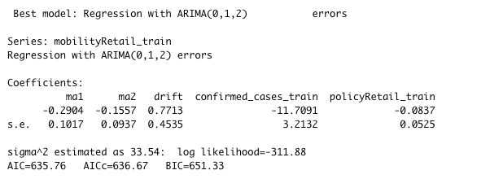
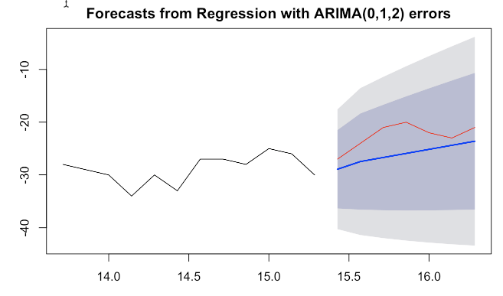
APPLY ARIMAX FOR ALL STATES
Model output for IL retail mobility
6
Mobility
51
States
7
Days changes in the future

Slide 15
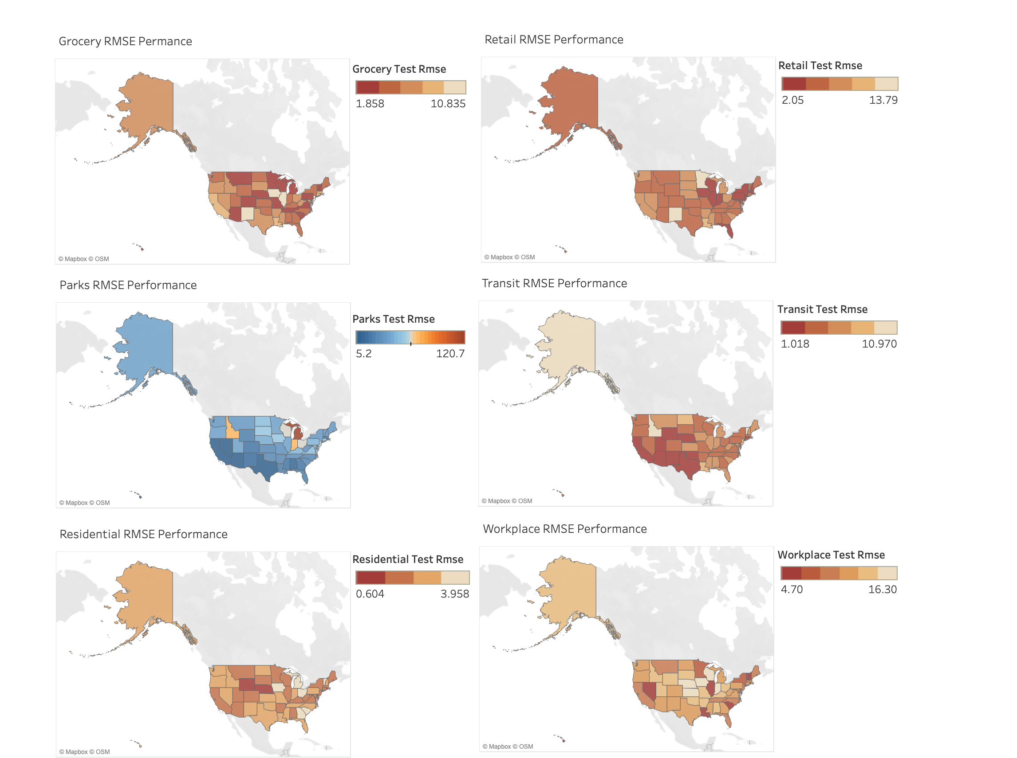
Arimax performance on 51 states for 6 mobilities
Retails
Grocery and Pharmacy
Parks
Transit stations
Residentials
Workplaces

Slide 16

7 Days predictions with no policies change

Slide 17
Insights from predicted mobility
Workplaces mobility is bouncing back to the baseline but still under the original levels
Midwest states recover transit mobility and grocery-pharmacy mobility faster than other states due to less severe COVID-19 conditions
All states have high residential mobility which means people stay home longer than usual because of COVID-19 prevention
Almost all states are holding conservative attitudes to retail, such as shopping or entertainment activities, but open attitude to parks visiting.
-

Slide 18
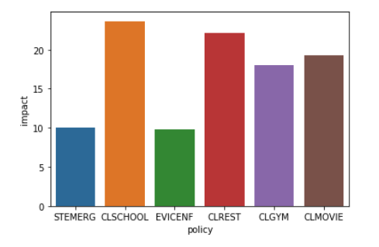
Bayesian framework on linear regression
Why THIS MODEL
Compared to ARIMAX, Bayesian generates a distribution for each coefficient instead of fixed number
Examine each policy’s effect on mobility
Robust analyses when we don’t have too many data points
Better prediction results by using ensemble methods
limitations
Due to computational efficiency, only retail and recreation mobility of Illinois was run

Slide 19
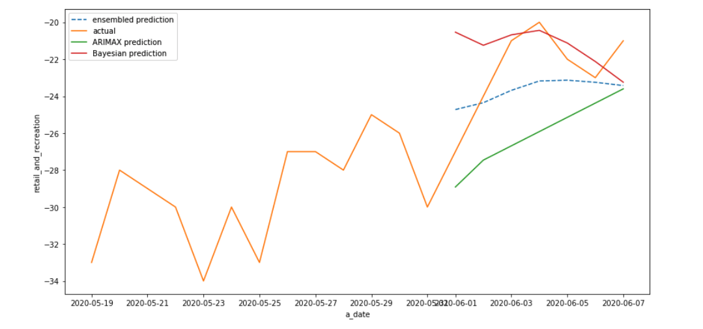
Ensembled prediction Result

Slide 20
03.
Pipeline
A tool to help state-level policy makers with decision makings

Slide 21
Design strategies
Target users
State-level policy makers
Purpose
The pipeline models and forecasts mobility for the next seven days, according to users’ proposed changes on existing policies. Predicted mobility can then be used to predict future confirmed cases.
Significance
We provide policy makers with insights into how to transition into each recovery stage of COVID-19
Step 1. Review of current policies and COVID-19 situation
Step 3. Simulate mobility for the next seven days
Step 2. Users propose changes to existing policies
Step 4. Simulate future confirmed cases
Notes:
Highlighted boxes are what we focus on.
Step-2 is the only part where it is user-initiative

Slide 22
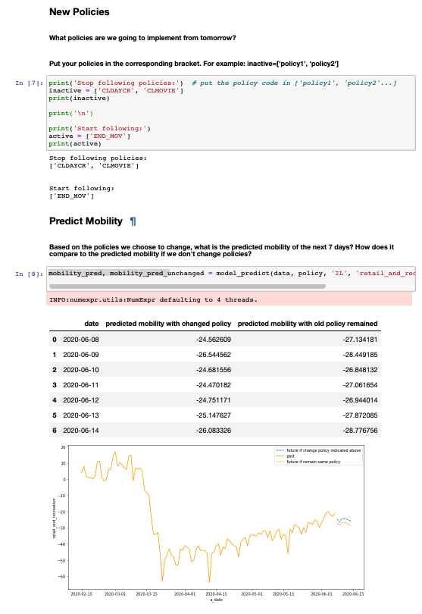
Deliverable
Users’ input
A jupyter notebook where users indicate state, mobility type interested, and changes to existing policies.
Demo: https://github.com/JennyZhen95/covid-19-hackathon/blob/master/pipeline/PipelineRun.ipynb
Automated forecast

Slide 23
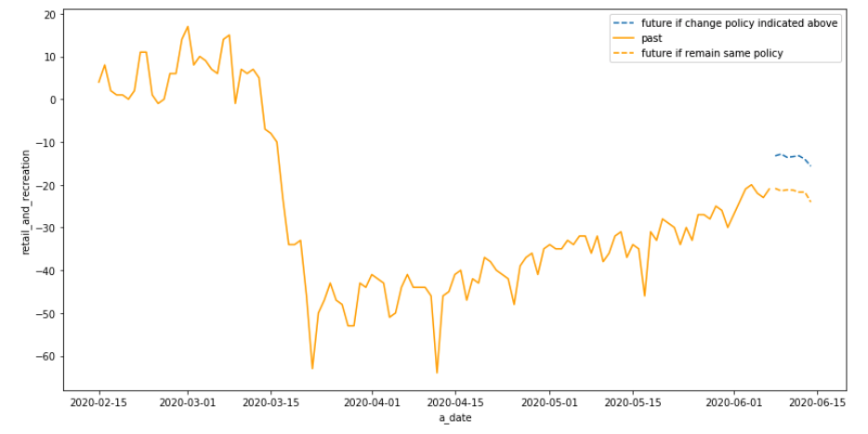
CASE: What about future if we open up daycare and movie theatres?

Slide 24
04.
conclusions
Insights from this project

Slide 25
Actionable insights
Loosening up policies, such as reopening daycare and theatres, does increase mobility. However, policy makers should still be cautious as the relationship between mobility and COVID-19 spreading is not investigated.
Policy makers can use our tool to simulate future mobility reactions to changes on existing policies.

Slide 26
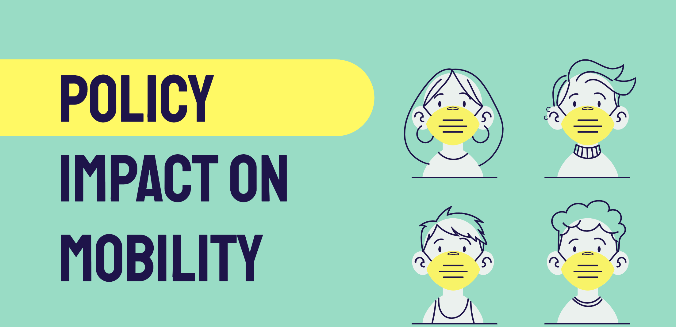
Future works
1. Use the most recent datasets that will be updated daily
2. Improve pipeline user interface
3. Increase the selections of policies
4. Extend the prediction time windows from 7 days to further

Slide 27
THANKS!
Do you have any questions?
nizhen@uchicago.edu
licao@uchicago.edu
yuyangzh@uchicago.edu
Project Github link:
https://github.com/JennyZhen95/covid-19-hackathon

Slide 28
APPENDIX

Slide 29
Policy quantification - based on mobility change around policy date
5 days before policy activated
5 days after policy activated
Take average as policy effect
FOR EACH MOBILITY AND ALL STATES
FOR EACH MOBILITY AND ALL STATES
Calculate 5 days mobility changes for all states before the policy is announced
Evaluate 5 days mobility changes for all states after the policy is announced

Slide 30

Potential Improvement on Pipeline
Connect to a daily updated data source
Cannot take new policies as input
Refer to other states’ data if similar policies have been implemented there
Intuitively categorize the new policies based on our previous clustering analyses.
Extend prediction window using richer data sources
Better user interface, e.g. D3.javascript

